Slide 1

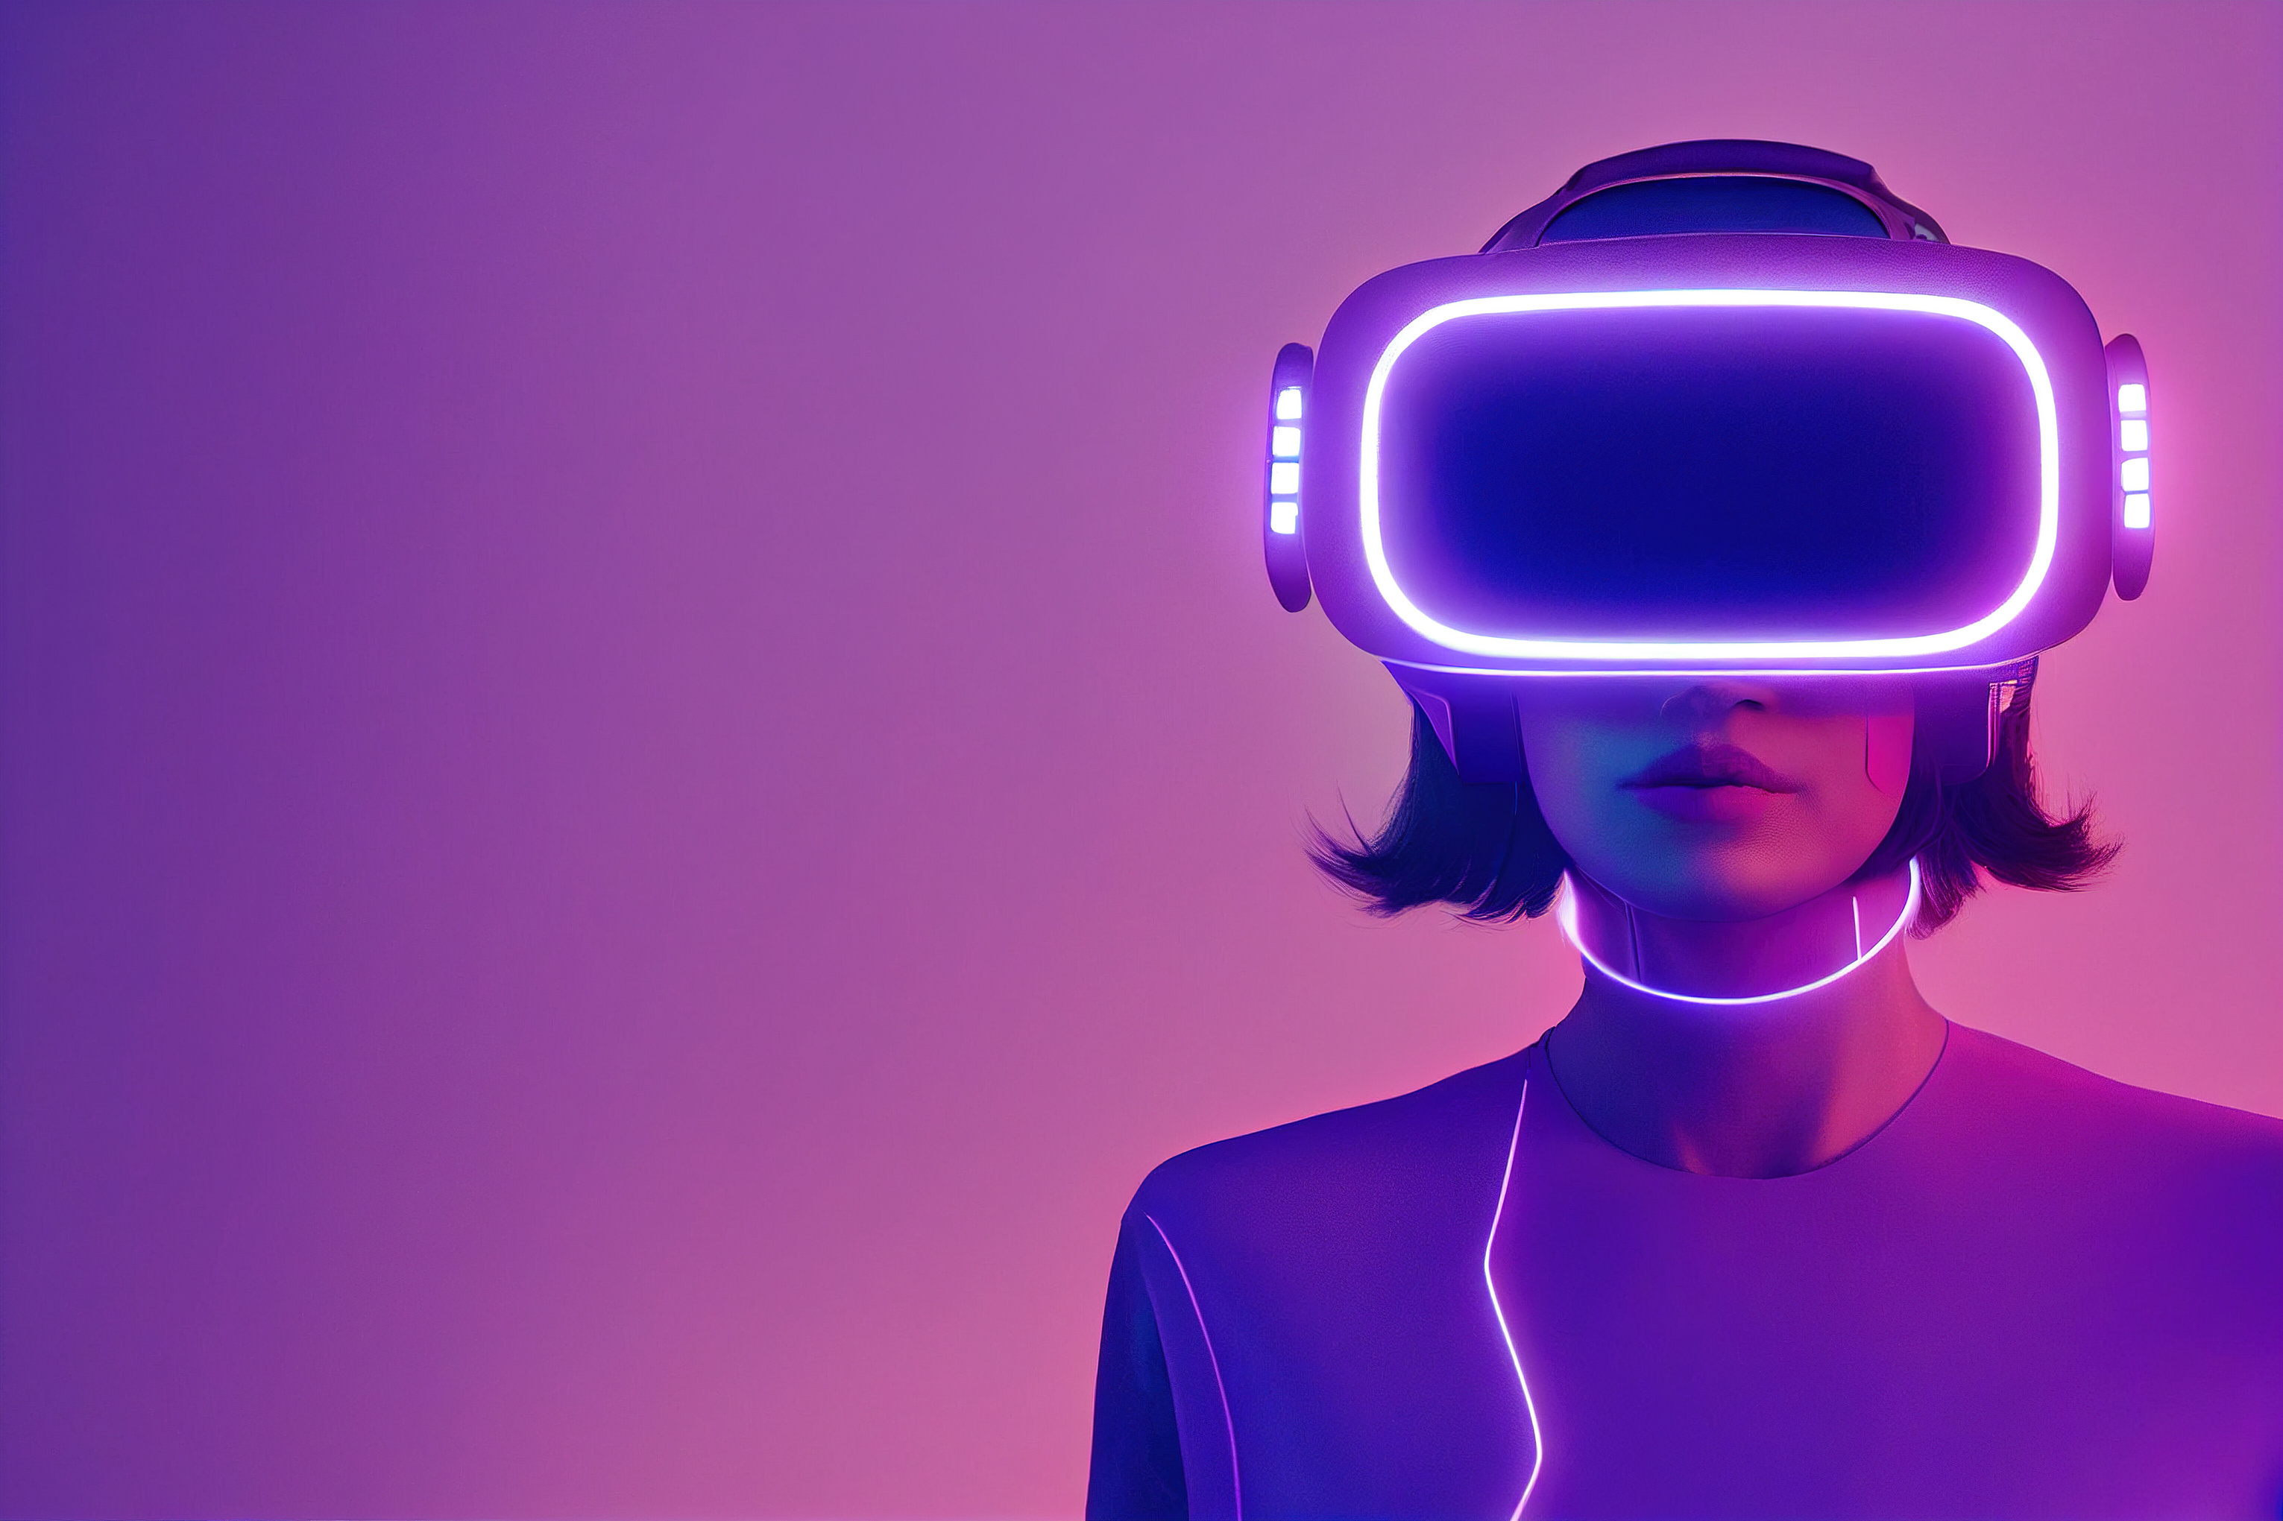

report on Use of ai by
Deepfake
Let’s start!
presented by:-
Shikhar garg
Piyush vashisth
yugdeep parihar
jayveer chauhan

Slide 2

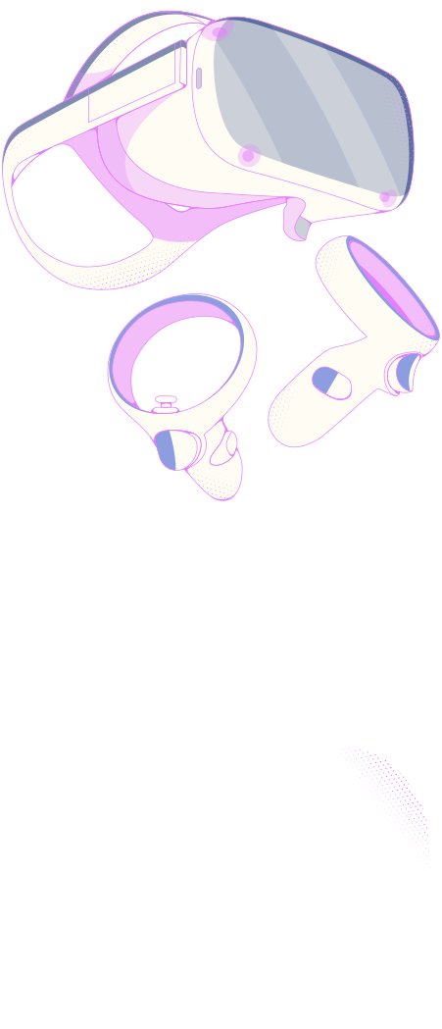

table of contents
1
Introduction
2
Technologies
3
Detection/Advancements
4
Comparitive Analysis
5
Future scope
6
Conclusion

Slide 3
welcome!
Deepfake AI refers to the use of artificial intelligence (AI) techniques, particularly deep learning algorithms, to create or manipulate digital content, such as videos or images, in a way that can be highly convincing and often difficult to differentiate from authentic content. The term "deepfake" is derived from "deep learning" and "fake."
Let’s begin!

Slide 4
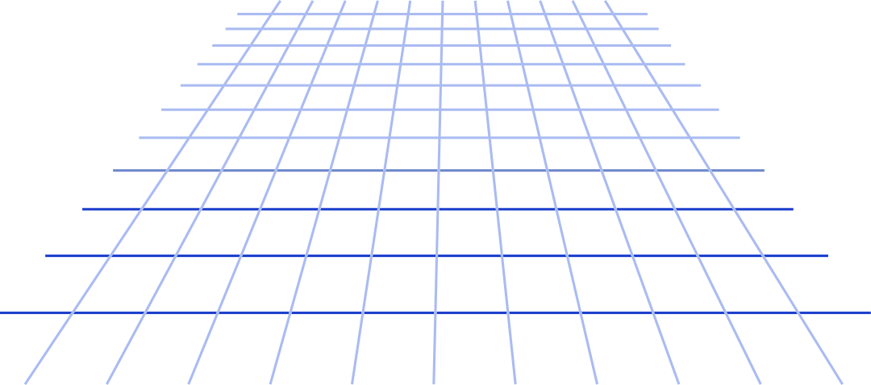
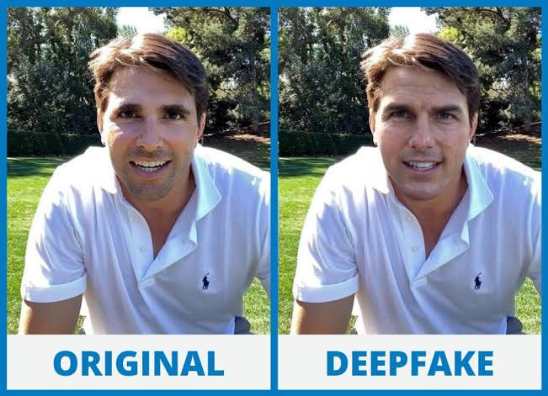
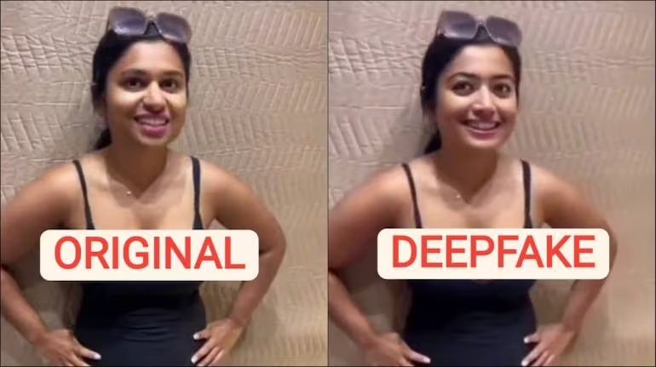
images created by the Deepfake AI

Slide 5
When was Deepfake invented?
The term came to be used for synthetic media in 2017 when a Reddit moderator created a subreddit called “deepfakes” and began posting videos that used face-swapping technology to insert celebrities' likenesses into existing pornographic videos.
Deepfake came into existance in April 2018, when Jordon Peele collabrated with Buzzfeed to create a deepfake of Barack Obama with Peele’s voice.

Slide 6
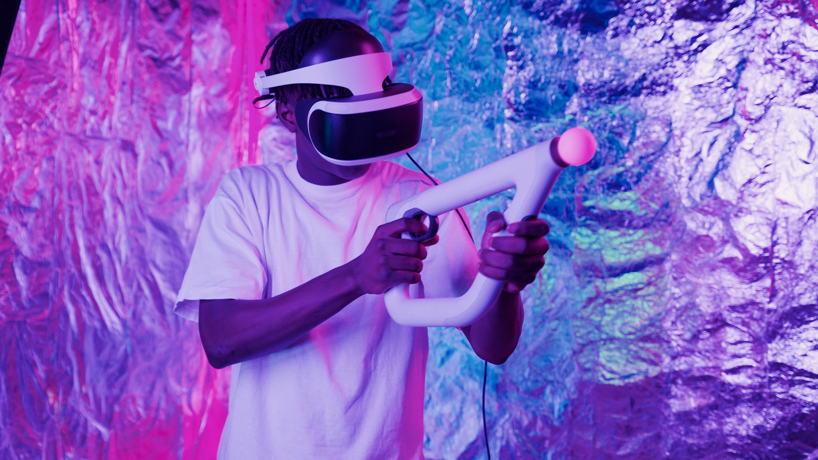
technology
used
Deepfake technology typically involves the use of deep neural networks, particularly generative models like Generative Adversarial Networks (GANs) or autoencoders. These models are trained on large datasets of real images or videos to learn the patterns and features present in the data. Once trained, they can generate new content or modify existing content by applying the learned patterns.

Slide 7

1
Gnerative Adversarial Networks -
The generator in a GAN creates synthetic data(such as images or videos). The discriminator evaluates the generated data and tries to distinguish between real and fake ones. The generator and the discriminator are trained in adversarial manner, with generator aimimg to create increasingly difficult content for discriminator to distinguish from the real data.

Slide 8
2
Autoencoders -
It consists of encoders and decoders, where an autoencoder compresses data into lower-dimensional representation and decoder reconstructs the original data from compressed representation. It is trained to minimize the difference between the input and the reconstructed output. It is use to learn the key feature of a persons face

Slide 9
3
VAriational Autoencoders -
VAE’s are a type of encoders that introduces a probabilistic element to encoding process, allowing more diverse range of generative outputs. These are often use to generate new realistic faces or content by sampling from learned probability distribution in latent space

Slide 10
4
Deep neural networks -
Deep neural networks, which include convolutional neural networks (CNNs) for image processing and recurrent neural networks (RNNs) for sequential data, are also employed in various stages of deepfake creation. CNNs are particularly effective for capturing spatial features in images, while RNNs are useful for modeling temporal aspects in videos.

Slide 11
5
Trsnsfer learning -
Pre-trained deep learning models, such as those for facial recognition or image classification, can be used as a starting point for deepfake generation. Transfer learning allows leveraging knowledge gained from one task (e.g., face recognition) for another (e.g., deepfake creation).

Slide 12

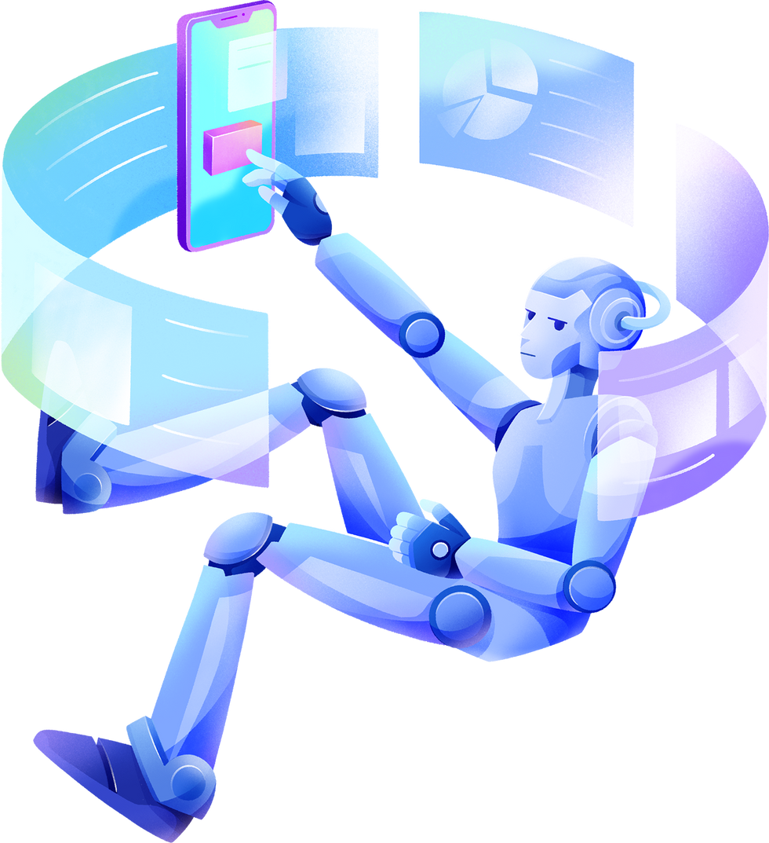

DETECTING DEEPFAKES
Metadata Analysis: Examining file data, timestamps, and source information to verify authenticity.
Face and Body Analysis: Comparing facial or body movements for inconsistencies or irregularities that indicate manipulation.
Forensic Analysis: Pixel-level analysis to identify discrepancies, such as unnatural lighting or inconsistencies in image composition.
Audio Analysis: Spectrogram analysis to detect alterations or anomalies in voice patterns.

Slide 13
ADVANCEMENTS IN DEEPFAKE DETECTION TECHNOLOGY:
Machine Learning Algorithms: Development of AI-based algorithms specifically designed to detect deepfakes by analyzing patterns and discrepancies.
Deepfake Databases: Creation of databases that collect and store deepfake samples to train algorithms and improve detection accuracy.
Collaborative Efforts: Collaboration between researchers, tech companies, and government bodies to advance detection methods and share insights.
Real-Time Detection Tools: Development of tools capable of detecting deepfakes in real-time, aiding in immediate identification and prevention of dissemination.

Slide 14
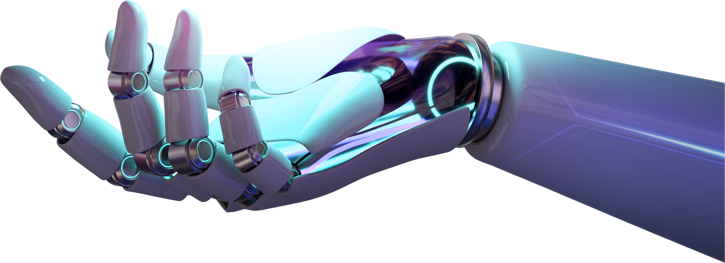
Some Other AI similar to deepfake -
Style Transfer
AI models can be trained to transfer the artistic style of one image onto another. This is often used for creating visually appealing images or videos with a particular artistic flair.

Slide 15
Image-to-Image Translation:
Models can be trained to convert images from one domain to another. For example, turning satellite images into maps, black and white photos into color, or sketches into realistic images.
Speech Synthesis
Text-to-speech (TTS) systems use AI to convert written text into spoken words. Some advanced models can generate highly natural-sounding human-like voices.

Slide 16
Super-Resolution:
AI models can enhance the resolution of images, making them sharper and clearer. This is used in applications like upscaling low-resolution images or improving the quality of video content.
Automated Translation:
Neural machine translation (NMT) models use AI to automatically translate text from one language to another. These models have significantly improved translation quality compared to traditional methods.

Slide 17
Advantages of DeepFake AI
Entertainment and Creative Arts:
Accessibility in Content Creation:
Training and Simulation:
Deepfakes can be utilized for training simulations in various fields, such as healthcare, aviation, and law enforcement.
Used for enhancing the visual experience in movies, television shows, and video games
Deepfake tools can simplify content creation for filmmakers, animators, and other digital artists

Slide 18
DisAdvantages of DeepFake AI
Misinformation and Manipulation:
Privacy Concerns:
Security Threats and Fraud:
Deepfakes raise serious privacy concerns as they can be used to create fabricated content that invades an individual's personal space.
Most significant drawbacks of deepfake is its potential for spreading misinformation and manipulating public perception
Deepfakes can be exploited for various security threats and fraudulent activities.

Slide 19
future scope
Predicting the future of deepfake technology involves several possibilities like:-
1
Improved Generative Models
2
Real-time Applications
3
Explainability and Transparency
4
Detection and Forensics
5
Ethical and Legal Frameworks

Slide 20
Conclusion
Evolution of Deepfake Technology Deep learning has driven the evolution of deepfake technology.
Complex Intersection of AI and Multimedia Manipulation, deepfakes exist at the complex intersection of artificial intelligence and multimedia manipulation.
Ethical Concerns and Risks proliferation of deepfakes raises ethical concerns.
Ever-Evolving Landscape the landscape of deep learning and deepfake technology is constantly evolving.
Responsible Innovation responsible innovation is crucial in navigating the positive potential and challenges of deepfake technology.

Slide 21
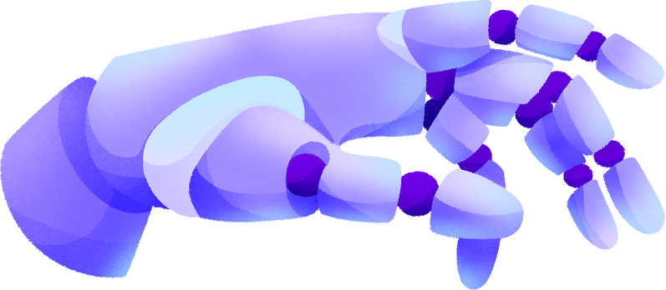

references
www.wikipedia.com
www.ZDNet.com
Chat GPT

Slide 22
Thank
you!

